Slide 1
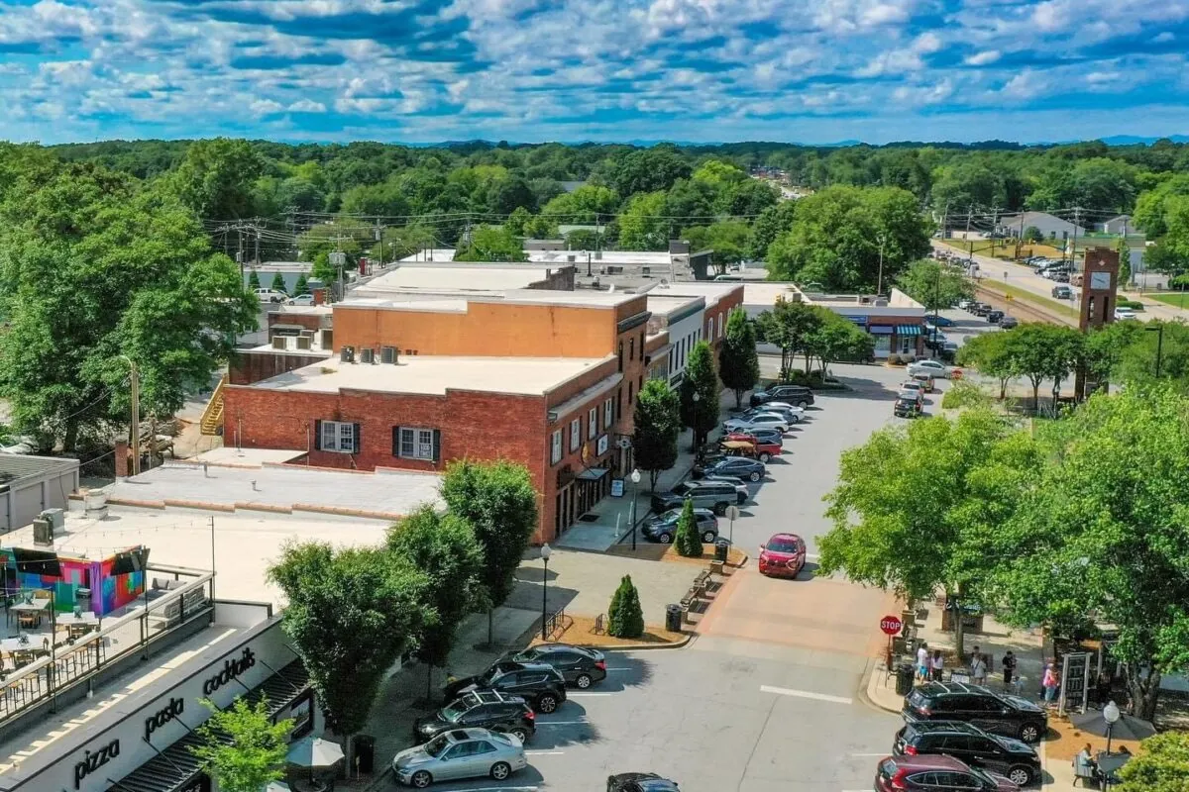

Impact Fee Overview
Presentation to City of Simpsonville City Council
September 8,2026

Slide 2

Abbeville County
Georgetown County
Aiken County
Greenville County
Anderson County
Horry County
Beaufort County
Orangeburg County
Beaufort Co. School Dist.
Clover School District
Summerville
Fort Mill Schools
York County
Rock Hill
Lancaster County
Lancaster County School District
Jasper County
Jasper County School District
Lexington County
Easley
Tega Cay
Clemson
Chester County Schools
York School District 1
Pageland
Winnsboro
Moncks Corner
Dorchester District 2
Fountain Inn
Greer
Clinton
Richland County
Inman
Dorchester District 4
Woodruff
Central
Colleton County
Laurens County
Cherokee County
Cherokee County Schools
Orangeburg County
  Impact fees/infrastructure financing strategies
  Fiscal/economic impact analyses
  Capital improvement planning
  Infrastructure finance/revenue enhancement
  Real estate and market feasibility

Slide 3
Basic Options for Funding Infrastructure
  Funding from broad-based revenues (property, income, sales taxes)
  Gas tax
  Special Assessment Districts
  Federal/State sources
  P3’s
  Tolls
  Pioneering agreements
  Exactions
  Obtained through development approval process (e.g., half street improvements)
  Accept lower levels of service!

Slide 4
Impact Fee Fundamentals
One-time payment for growth-related infrastructure, usually collected at the time buildings permits are issued
Can’t be used for operations, maintenance, or replacement
Not a tax but more like a contractual arrangement to build infrastructure, with three requirements
  Need (system improvements, not project-level improvements)
  Benefit
    Short range expenditures
    Geographic service areas and/or benefit districts
  Proportionate

Slide 5
Conceptual Impact Fee Calculation
Demand Units per Development Unit | Infrastructure Units per Demand Unit | Dollars per Infrastructure Unit
2.5 persons per SFD unit x 5 acres per 1,000 persons x $100,000 per acre =
0.0125 acres per SFD Unit @ $1,250 per SFD Unit

Slide 6
Impact Fees in South Carolina
Code of Laws of South Carolina, Section 6-1-910 et seq.
Impact fee revenue must be maintained in an interest- bearing account
Monies must be spent within 3 years of scheduled date for construction in the CIP
Must publish an Annual Monitoring Report
Comprehensive review and update every 5 years
All maximum allowable fee changes require an updated study
Requires an analysis that estimates the effect of imposing impact fees on affordable housing in the City

Slide 7
Infrastructure Categories Allowed by Act
Water
Wastewater
Transportation
Solid waste
Stormwater
Public safety (police, fire, ems)
Parks and recreation
Libraries
Schools

Slide 8
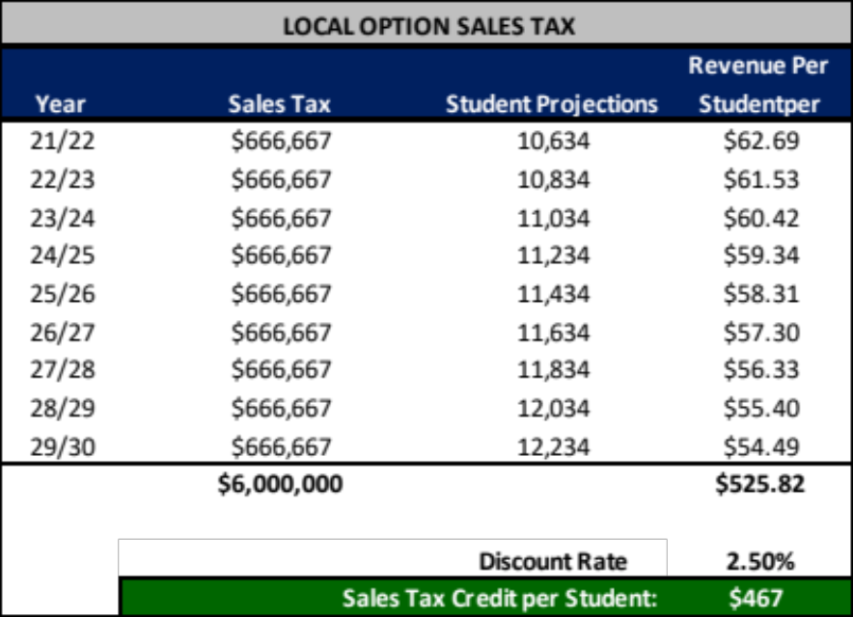
Evaluate Need for Credits
Site specific
  Developer constructs a capital facility included in fee calculations
Debt service
  Avoid double payment due to existing or future bonds
Dedicated revenues
  Property tax, local option sales tax, gas tax

Slide 9
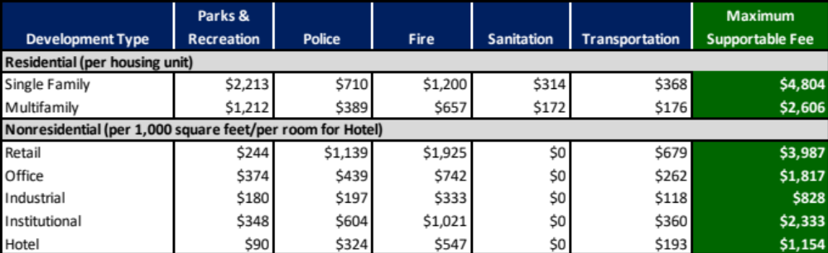
Fee Schedule
Implemented by ordinance/resolution
Mechanism for determining the cost to be recovered from new development
  How will fees be assessed?
  Residential categories?
  Nonresidential categories?
Usually in current dollars
  Many communities adjust annually for inflation using ENR Index or CPI

Slide 10
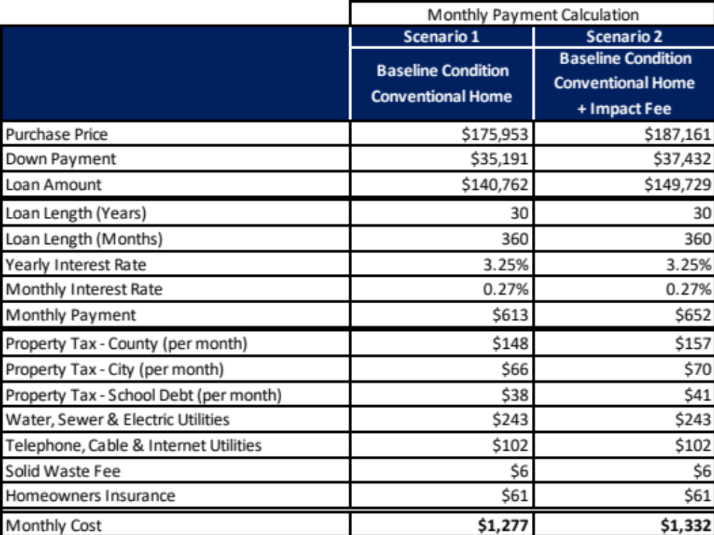
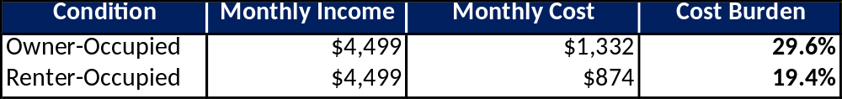
Affordable Housing Analysis
Notes:
An increase of $55 per month

Slide 11
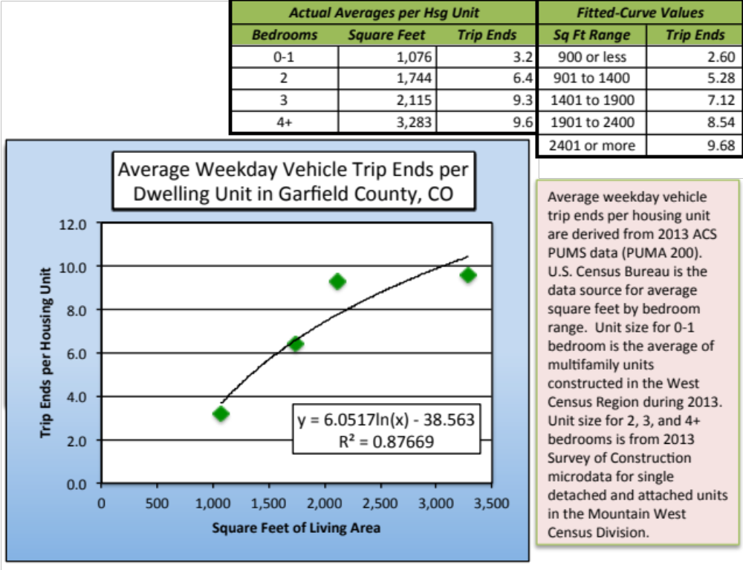
Progressive Residential Demand Factors

Slide 12
Common Impact Fee Methods
Cost Recovery (past)
  Oversized and unique facilities
  Funds typically used for debt service
Incremental Expansion (present)
  Formula-based approach documents level of service with both quantitative and qualitative measures
Plan-Based (future)
  Common for utilities but can also be used for other public facilities with non-impact fee funding

Slide 13
Myths and Misconceptions
  Impact fees cover the entire cost of new facilities, negating the need for higher taxes
    A “properly” designed fee may come close
    Credits
    How about the O&M costs?
  Impact fees should be based on planning standards, without concern for deficiencies
  Nonresidential fees can be “adjusted” for economic reasons
  All developers/builders hate impact fees

Slide 14
Myths and Misconceptions
  Impact fees negatively affect low/moderate income housing
    Credits for affordable housing can mitigate impact
    Fee not always passed-on in the price of the home; studies have shown that fees are often absorbed by others in the “food chain” depending on market conditions:
      Land owner
      Developer
      Homebuilder
      Homeowner
    Impact fee study includes affordability housing analysis

Slide 15
Process
  Determine existing development base and project future growth
  Determine existing levels of service and capital needs due to new growth
  Evaluate methodological alternatives
  Evaluate need for credits
  Calculate fees
  Evaluate impact on affordable housing
  Stakeholder outreach
  Meeting with Planning Commission
  Adoption process

Slide 16
Questions & Answers

